Slide 1
Big Mountain Resort – Analysis & Findings
Abhijit Pawar

Slide 2
What Is Big Mountain Resort?
Big Mountain Resort, is a ski resort located in Montana, which offers spectacular views of Glacier National Park and Flathead National Forest, with access to 105 trails.
Gets 35000 visitors annually
Has 11 lifts, 2 T-bars, and 1 magic carpet for novice skiers

Slide 3
Problem Statement & Identification
Big Mountain has recently installed additional chairs which has generated additional costs of $154000, so it is trying to see how much to increase ticket prices by in order to increase revenue to offset this cost increase.
In other words, by how much can Big Mountain Resort increase its ticket prices in order to increase revenue that will both increase revenue while also allowing Big Mountain to remain competitive and not losing customers

Slide 4
Procedure and Steps
For this Analysis I used a dataset that had information on other Ski resorts in Montana, and what they charge for ticket prices along with what they offer such as skiable terrain, summit elevation, base elevation, average snowfall, number or trams, quads, chairs, runs, triples, doubles, the longest run, average snowfall, snow making machine, and terrain parks
After which I did an EDA which compared Big Mountain with these other resorts for the above mentioned features
Analyzed four scenarios and how much Big Mountain should increase their ticket prices by in each of them.

Slide 5
General Findings
Compared to most other ski resorts in Montana and surrounding states, Big Mountain:
Higher vertical drop, more snow making, more chairs, more fast quads, more runs, more trams, and more skiable Terrain
Ticket Price wise it charges more than most of the other ski resorts in Montana and other surround states
These findings indicate that Big Mountain has better features compared to most of the other surrounding ski resorts, but also charges more than most of them.
Big Mountain already has a competitive advantage compared to them.

Slide 6
Modelling Scenarios
In order to see how much Big Mountain Resort can raise its ticket prices by, I came up with four modelling scenarios:
Scenario 1: Closing down 10 of the least used runs
Scenario 2: Increase the vertical drop by adding a run to a point 150 feet lower down but requiring the installation of an additional chair lift to bring skiers back up, without additional snow making coverage
Scenario 3: Same as number 2, but adding 2 acres of snow making cover
Scenario 4: Increase the longest run by 0.2 mile to boast 3.5 miles length, requiring an additional snow making coverage of 4 acres

Slide 7
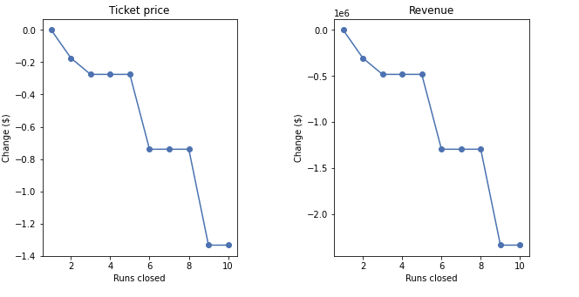
Scenario 1 Results
Results
Graph
The resort can close down up to 5 runs without having a big loss on ticket prices revenue
If it closes more than 6, it will suffer big loss in revenue

Slide 8
Scenario 2 Results
If Big Mountain adds a run, increases vertical drop by 150 ft, and installs an additional chair lift, it can increase its ticket costs by 8.70 which will subsequently increase revenue to 15271391

Slide 9
Scenario 3 Results
In addition to increasing vertical drop by 150 ft, adding a run, and installing an additional chair lift, if Big Mountain also adds 2 acres of snow making it can increase its ticket costs by 10.62 which will subsequently increase revenue to 18590580

Slide 10
Scenario 4 Results
Increasing the longest run by 0.2 miles, has no impact on ticket price increases

Slide 11
Conclusions
Big Mountain is already competitive when it comes to what it offers to its customers
If Big Mountain were to offer more to its visitors it can generate more revenue, thus offsetting the costs.

